Slide 1
Health Care Cost Prediction with:
Linear Regression
Logistic Regression
Linear Mixed model
Generalized Mixed Models
QBS121_BIOSTATS2
Presenters:
Ayush Chakraborty
Gibran Erlangga
Hyunjoe Yoo
Parinitha Kompala
Shrey Khetrapal

Slide 2
Introduction
Goal
Medical expenses are difficult to estimate because the most costly conditions are rare and seemingly random. Still, some conditions are more prevalent for certain segments of the population. For instance, lung cancer is more likely among smokers than non-smokers, and heart disease may be more likely among the obese.
The goal of this analysis is to use patient data to estimate the average medical care expenses for such population segments. These estimates can be used to create actuarial tables that set the price of yearly premiums higher or lower, depending on the expected treatment costs.
Notes:
PARI-In order for a health insurance company to make money, it needs to collect more in yearly premiums than it spends on medical care to its beneficiaries. As a result, insurers invest a great deal of time and money in developing models that accurately forecast medical expenses for the insured population.

Slide 3
Dataset
For this analysis, we will use a simulated dataset containing hypothetical medical expenses for patients in the United States. This data was created for using demographic statistics from the US Census Bureau, and thus, approximately reflect real-world conditions.And got this from Kaggel.
The insurance.csv file includes 1,338 examples of beneficiaries currently enrolled in the insurance plan, with features indicating characteristics of the patient as well as the total medical expenses charged to the plan for the calendar year. The features are:
age: An integer indicating the age of the primary beneficiary (excluding those above 64 years, since they are generally covered by the government).
sex: The policy holder’s gender, either male or female.
bmi: The body mass index (BMI), which provides a sense of how over- or under-weight a person is relative to their height. BMI is equal to weight (in kilograms) divided by height (in meters) squared. An ideal BMI is within the range of 18.5 to 24.9.
children: An integer indicating the number of children/dependents covered by the insurance plan.
smoker: A yes or no categorical variable that indicates whether the insured regularly smokes tobacco.
region: The beneficiary’s place of residence in the US, divided into four geographic regions: northeast, southeast, southwest, or northwest.
Notes:
PARI-t is important to give some thought to how these variables may be related to billed medical expenses. For instance, we might expect that older people and smokers are at higher risk of large medical expenses. Unlike many other machine learning methods, in regression analysis, the relationships among the features are typically specified by the user rather than being detected automatically. We’ll explore some of these potential relationships in the next section.

Slide 4
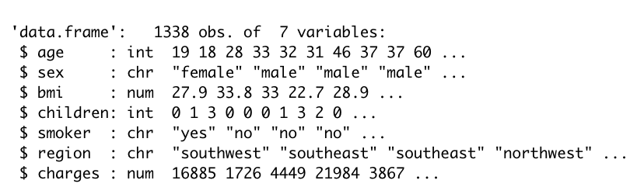
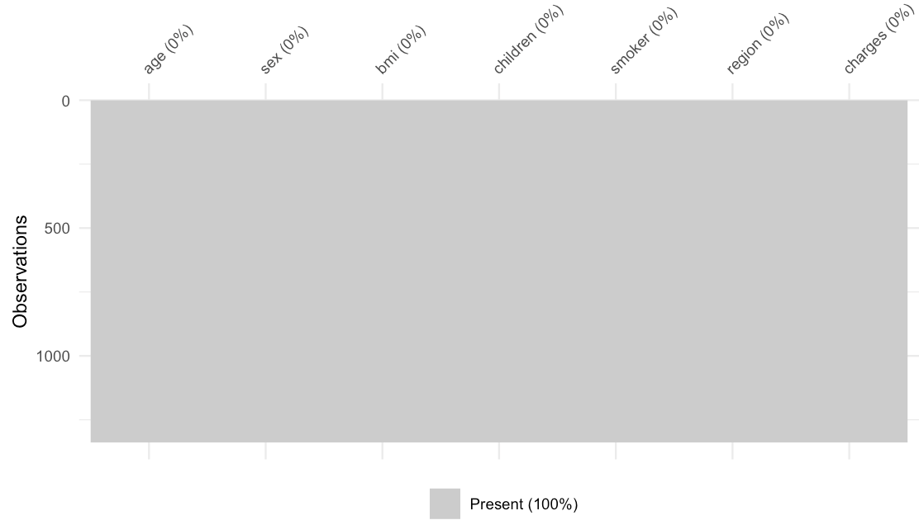
DATA EXPLORATION
The structure of our dataset.
Checking for missingness in the dataset
Notes:
Our model’s dependent variable is expenses, which measures the medical costs each person charged to the insurance plan for the year. Prior to building a regression model, it is often helpful to check for normality. Although linear regression does not strictly require a normally distributed dependent variable, the model often fits better when this is true.

Slide 5
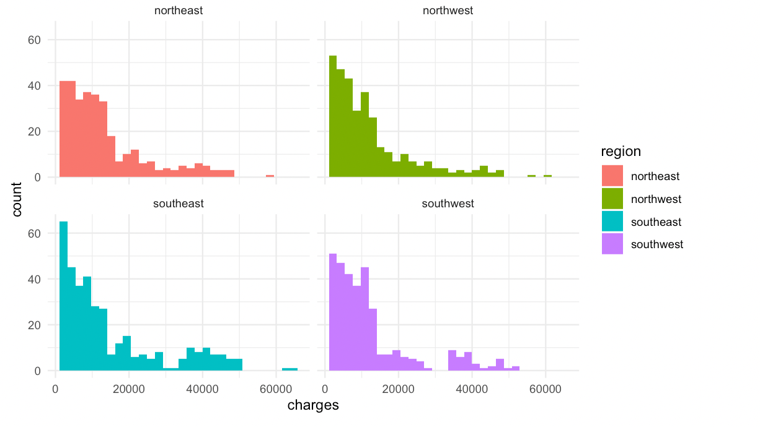
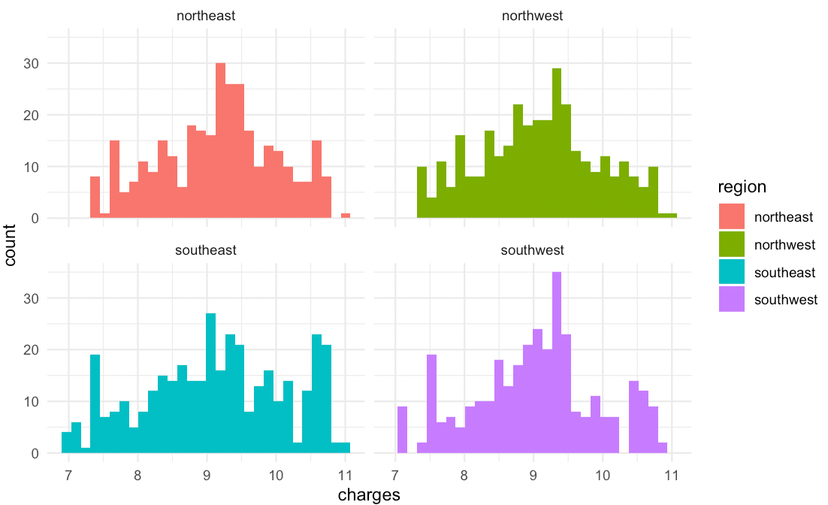
From this we can conclude that it is not normally distributed and is skewed right.
After adding log function to the variable

Slide 6
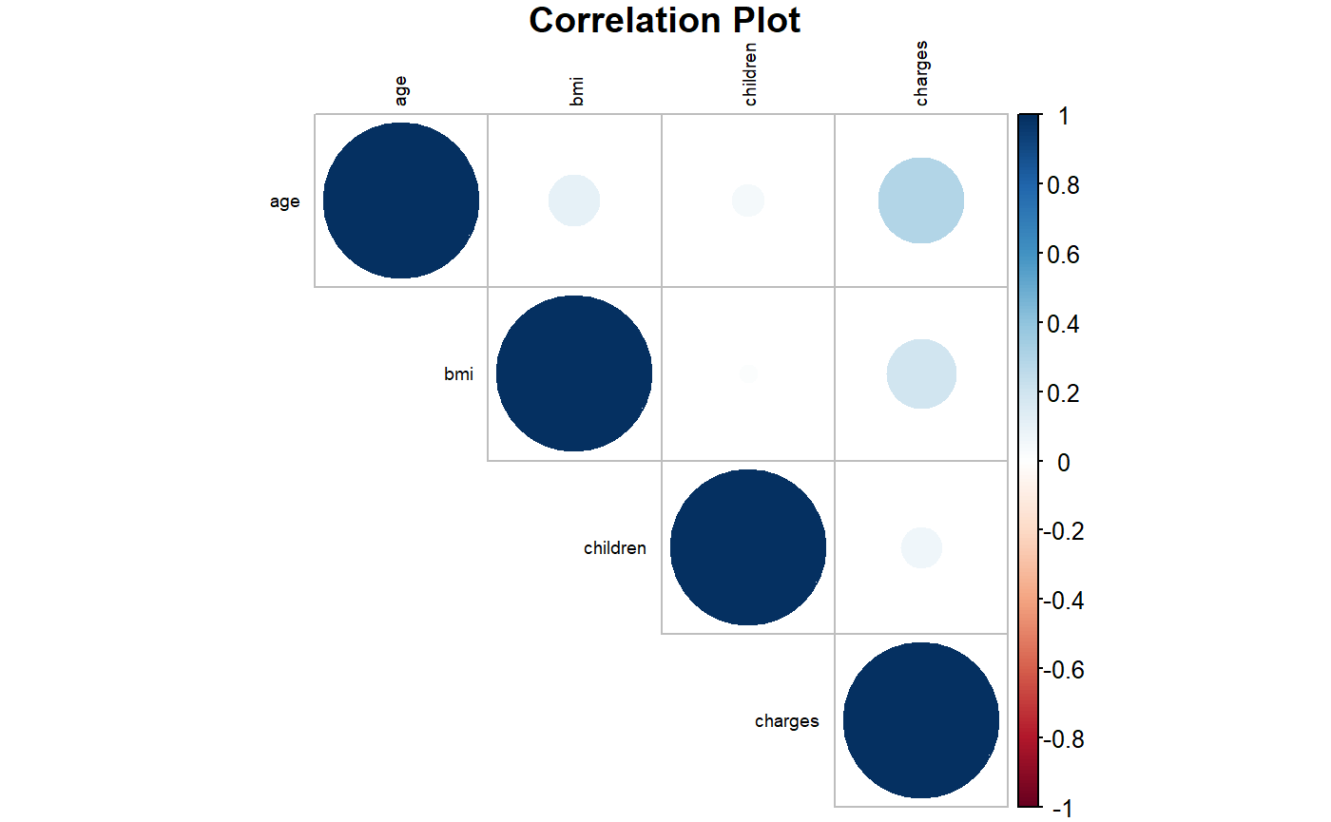
Correlation between the variables.
Notes:
Pari:From this we can say that charges are comparitive highly corelated with "age" followed by "bmi". And there is no correlation between "bmi" and "children".

Slide 7
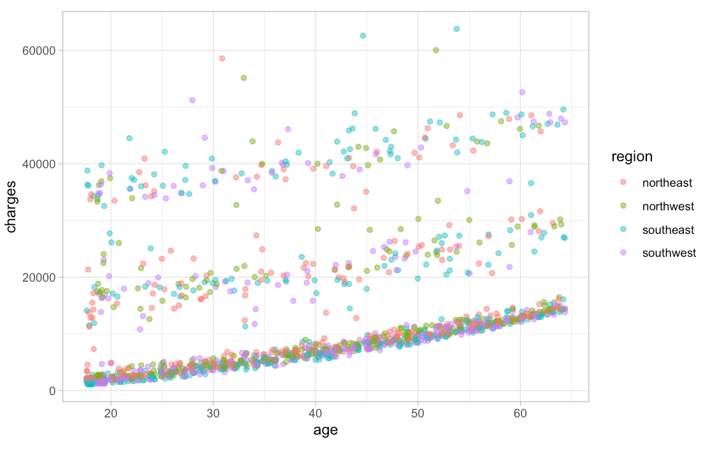
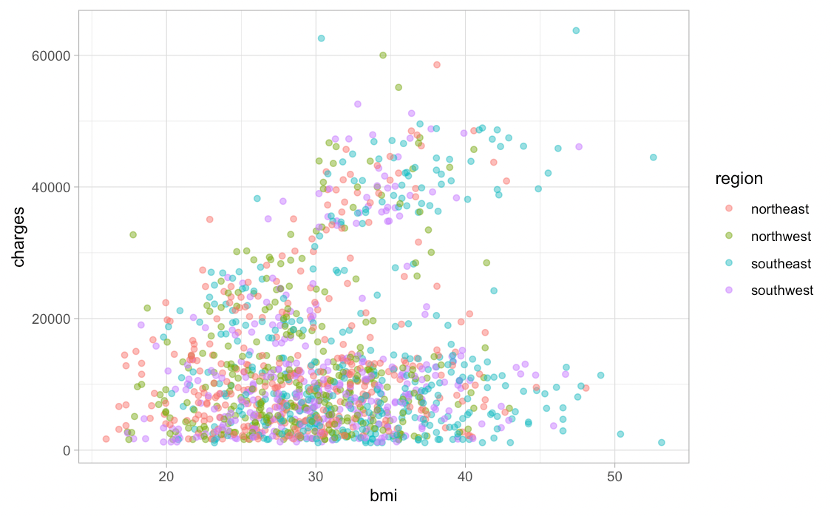
Looking into the correlation between charges and age, charges and bmi based on the region
As Age go up Charges for health insurance also trends up.

Slide 8
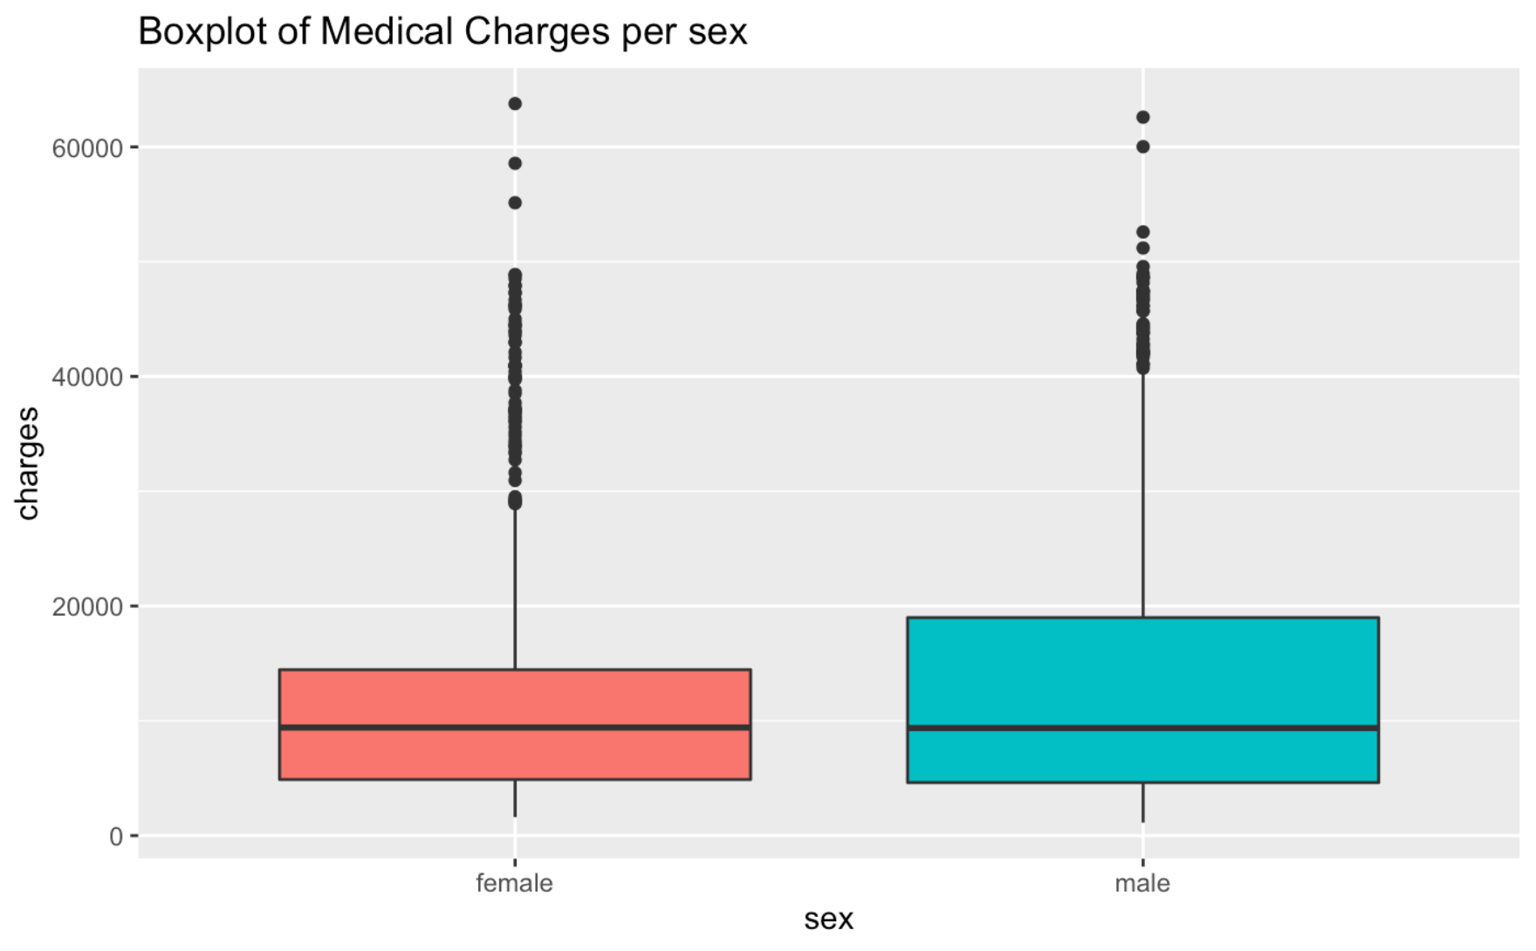
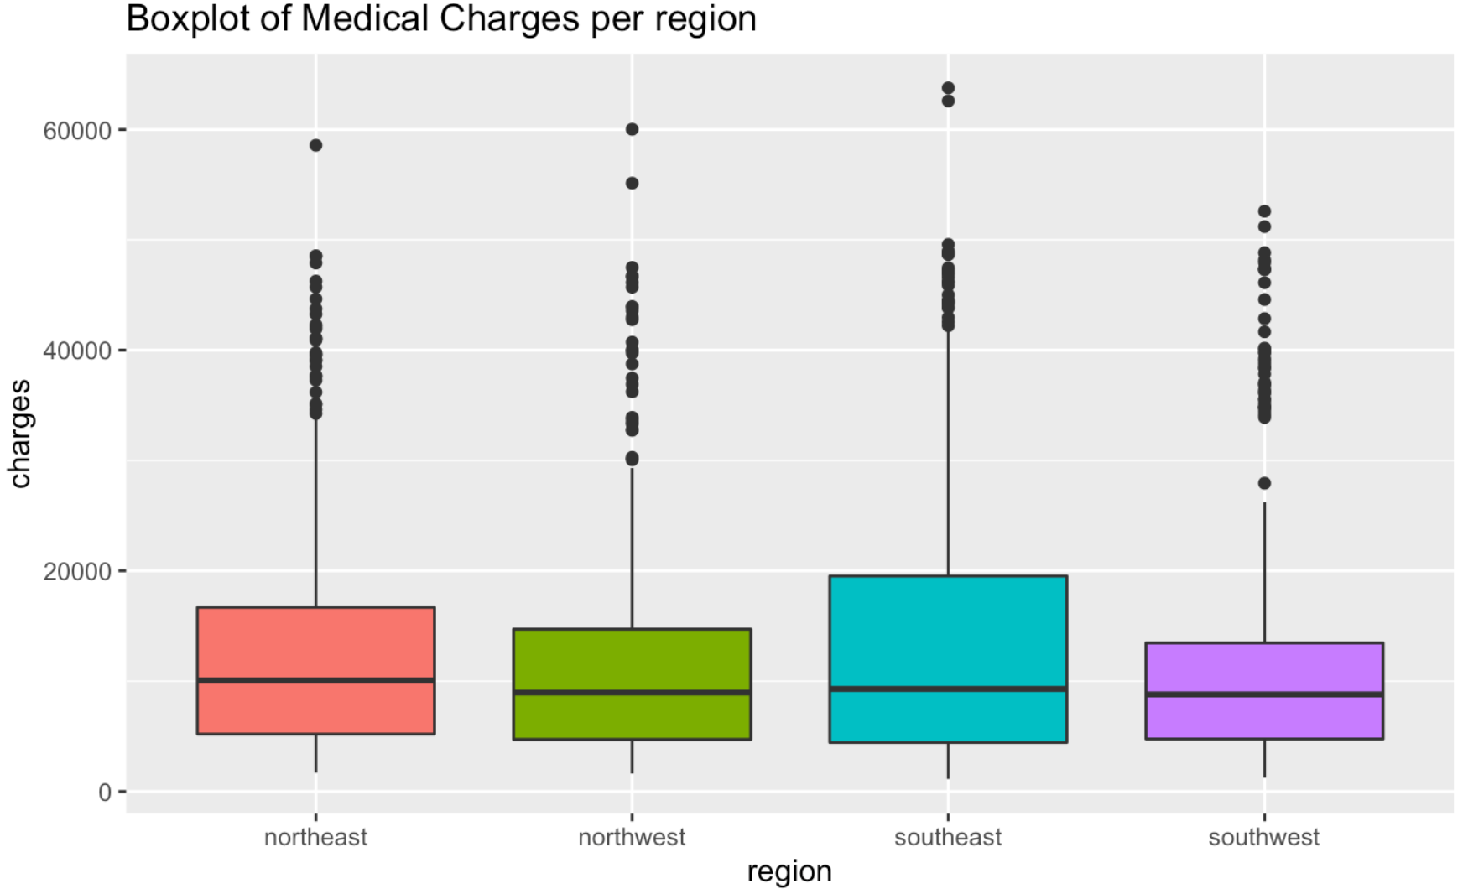
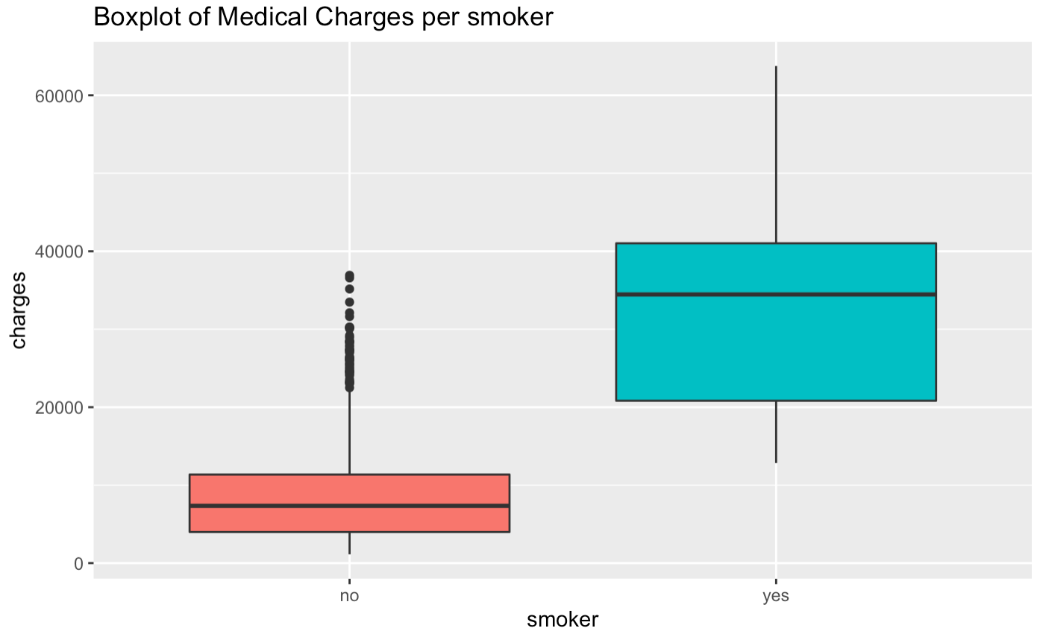
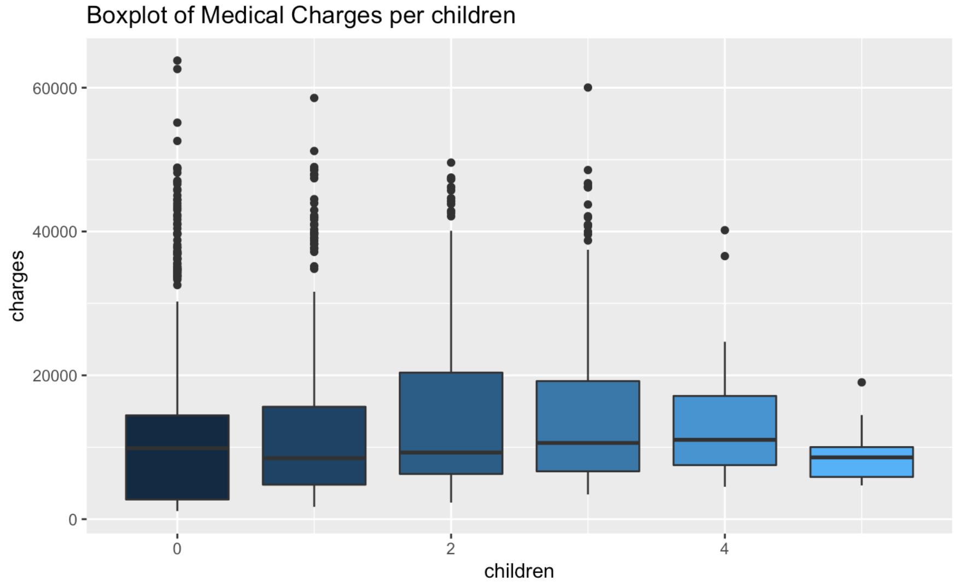
Dependent vs. Independent Variables
Notes:
Jess -
Here are the plots of dependent variable and independent variables.
We are looking at the distribution of medical charges based on sex, region, smoking status, and the number of children.
Based on the visualization, we can conclude that medical charges per smokers are much higher than that of non smokers.
And medical charges per children gets lower after 4.

Slide 9
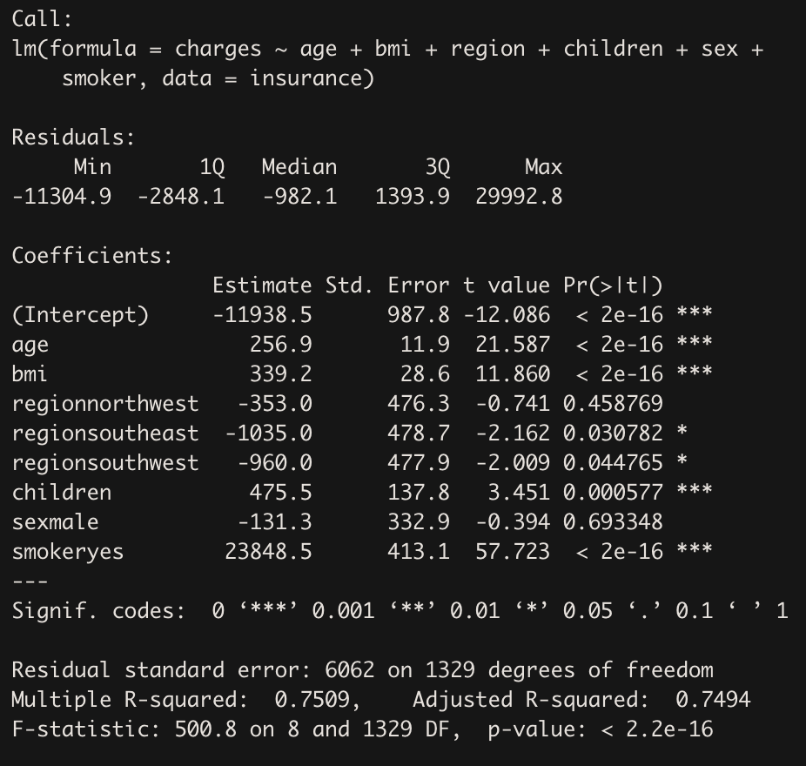
Linear Regression
Dependent variable: Insurance charges
Independent variable: Age, BMI, Region, Children, Sex, Smoker
P value < 0.05 → significant
Top significant variables:
Age, BMI, Children, Smoker
R-squared: 0.75 → 75% variance explained by the model
Notes:
Jess
Looking into the variables that affect the charges of insurance
The dependent variable/response variable is the insurance charges and the independent variable/predictors are .
Based on the p values from a wald test,
top 4 significant variables are: age, bmi, children, people who smoke
For multiple r-squared value, if it is 1, model completely explains variance in observations
And if it is 0, model explains nothing
In this model, we have r squared of 0.7509. Since the value is > 0.7, this model explains variance in observations.

Slide 10
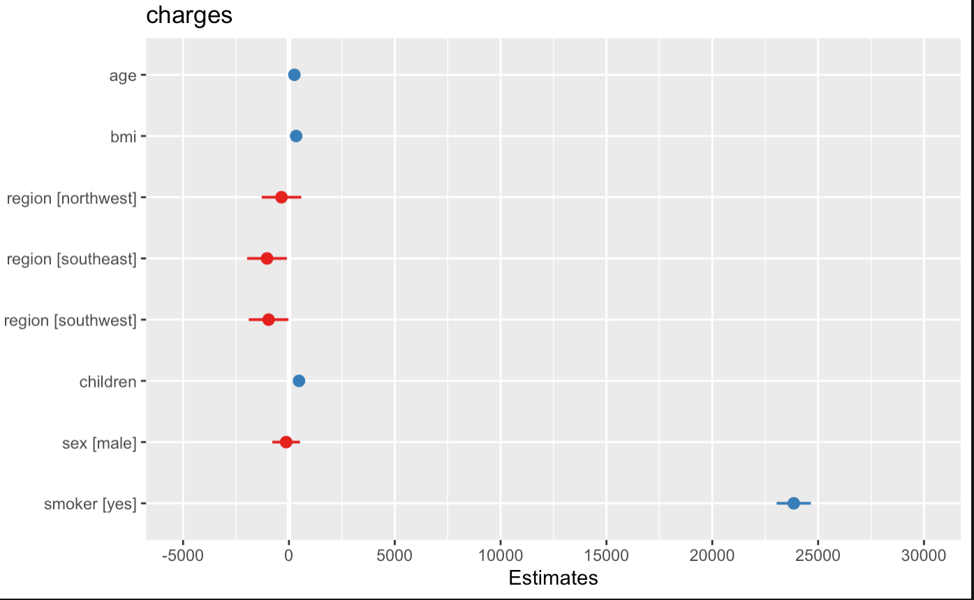
Linear Regression
Notes:
Jess
Here is the plot of estimates of the linear model.
The “neutral” line is on 0, which is the vertical intercept that indicates no effect.
From the graph, we can see that the medical charge estimate for smokers is the highest among the variables.

Slide 11
Logistic Regression
Intuition : Health care companies and High Risk Applicants
For the purpose of Logistic Regression we categorised each individual as a High Risk Applicant if he has attributes :
BMI > 25
Smoker Status : Yes
Age > 50
Notes:
shrey-

Slide 12
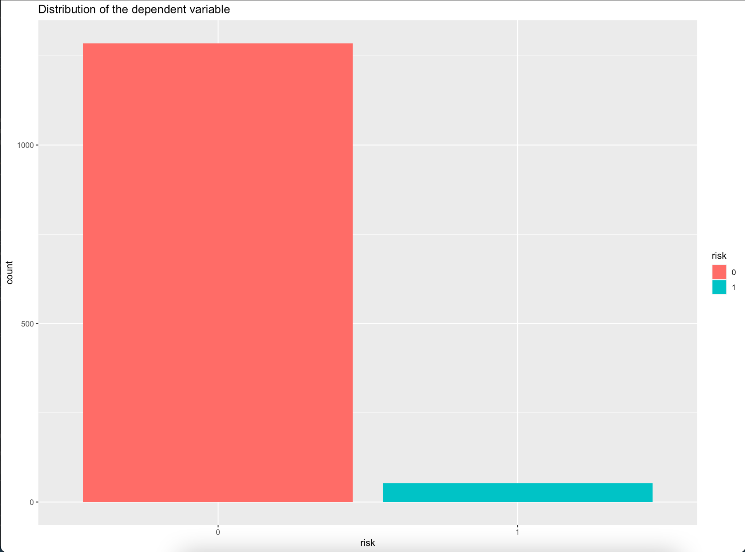
Logistic Regression
0 : 1258
1 : 53

Slide 13
Logistic Regression
Imbalance in classification problem
Oversample (eg SMOTE)
Downsample
Divide into Training and Test set (80-20)
Notes:
Could use oversampling techniques like SMOTE but kept it simple so that

Slide 14
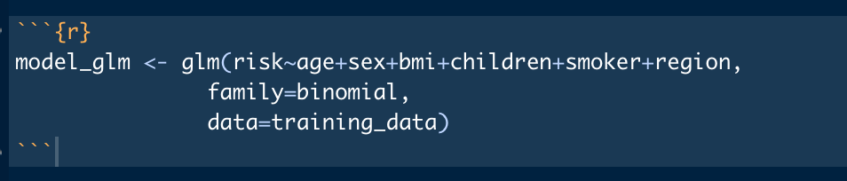
Logistic Regression
Notes:
We included all the available variables in the model

Slide 15
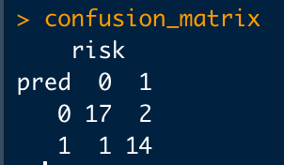
Logistic Regression
Confusion Matrix
Accuracy : 91.17 %
Recall : 87.5%
Notes:
Could use oversampling techniques like SMOTE but kept it simple so that

Slide 16
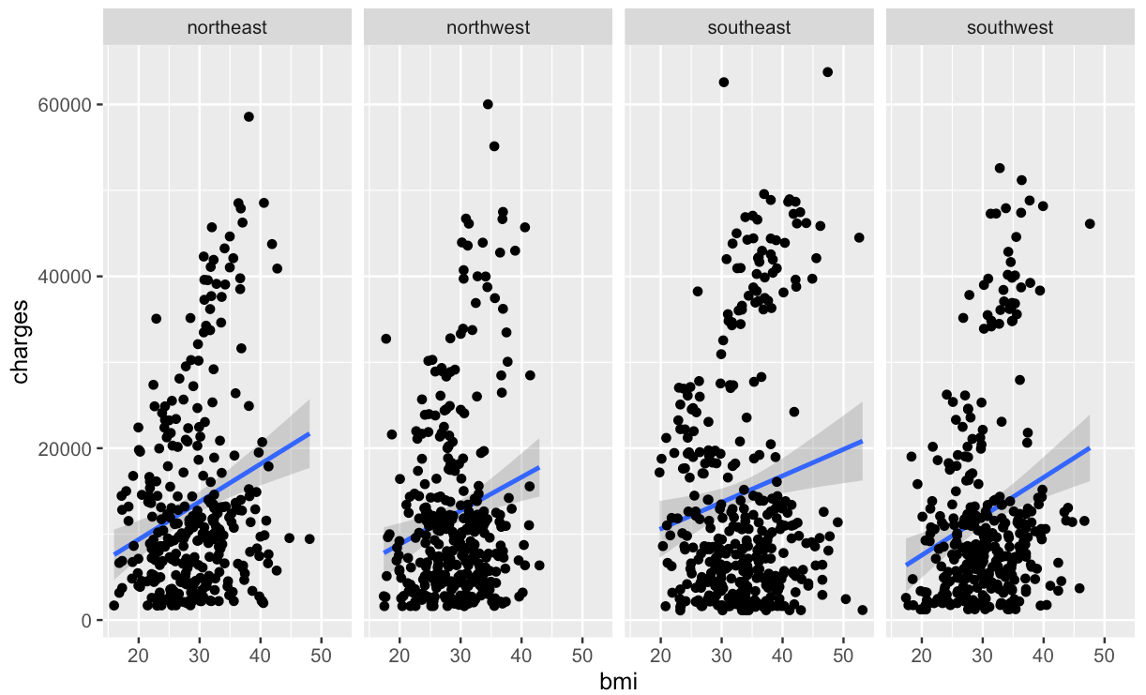
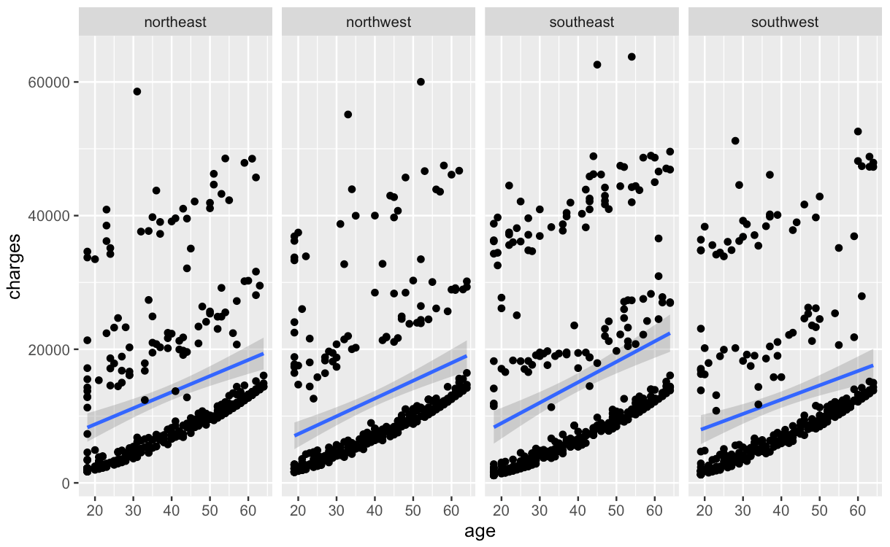
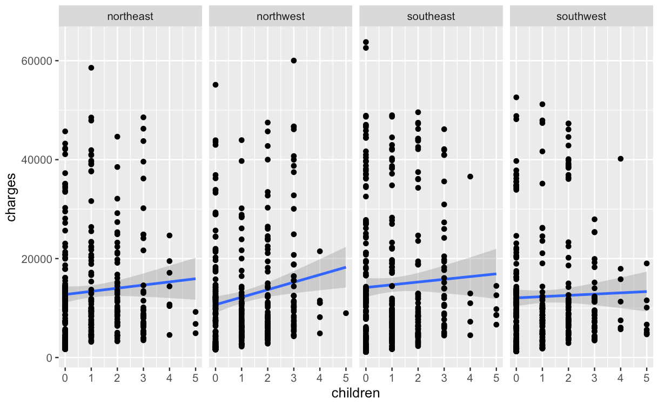
Linear Mixed-Effects Model (LMM)
Different intercept and slopes on each region for different variables
Not an ideal case for LMM because these trends have same direction (positive slope, upwards)
Notes:
gibran

Slide 17
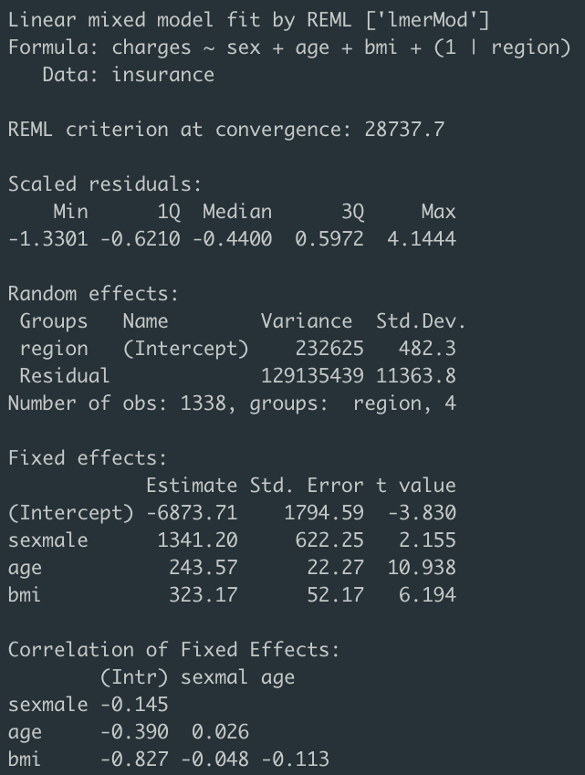
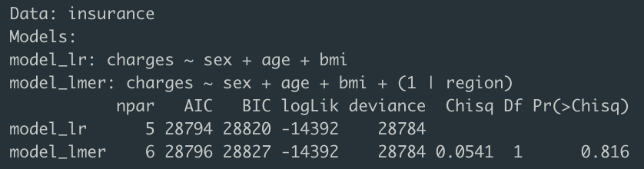
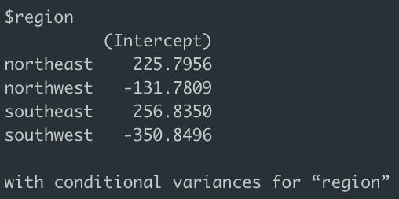
Linear Mixed-Effects Model (LMM)
1
2
3
Conclusion:
There is not much difference in variance happened between different regions, hence LMM is NOT needed and LM is better fit for this case
- (1 | region) as random effect to handle non-independence by introducing different intercepts for each region
- After running ANOVA between LR and LMM, the AIC BIC values increase between LMM compared to LR -> the model unnecessarily increase the complexity without improving the fit to the data
Notes:
gibran

Slide 18
Generalized Linear Mixed Model (GLMM) on logistic regression
Why are we using the method?
Provides information about whether individual variation amongst regions is significant.
To see if there is a different trends compared to overall in the regions.
What variables used in the model
Fixed - effect variables: Sex, Age, Children, Smoker
Random - effect variables: Region
Notes:
Ayush

Slide 19
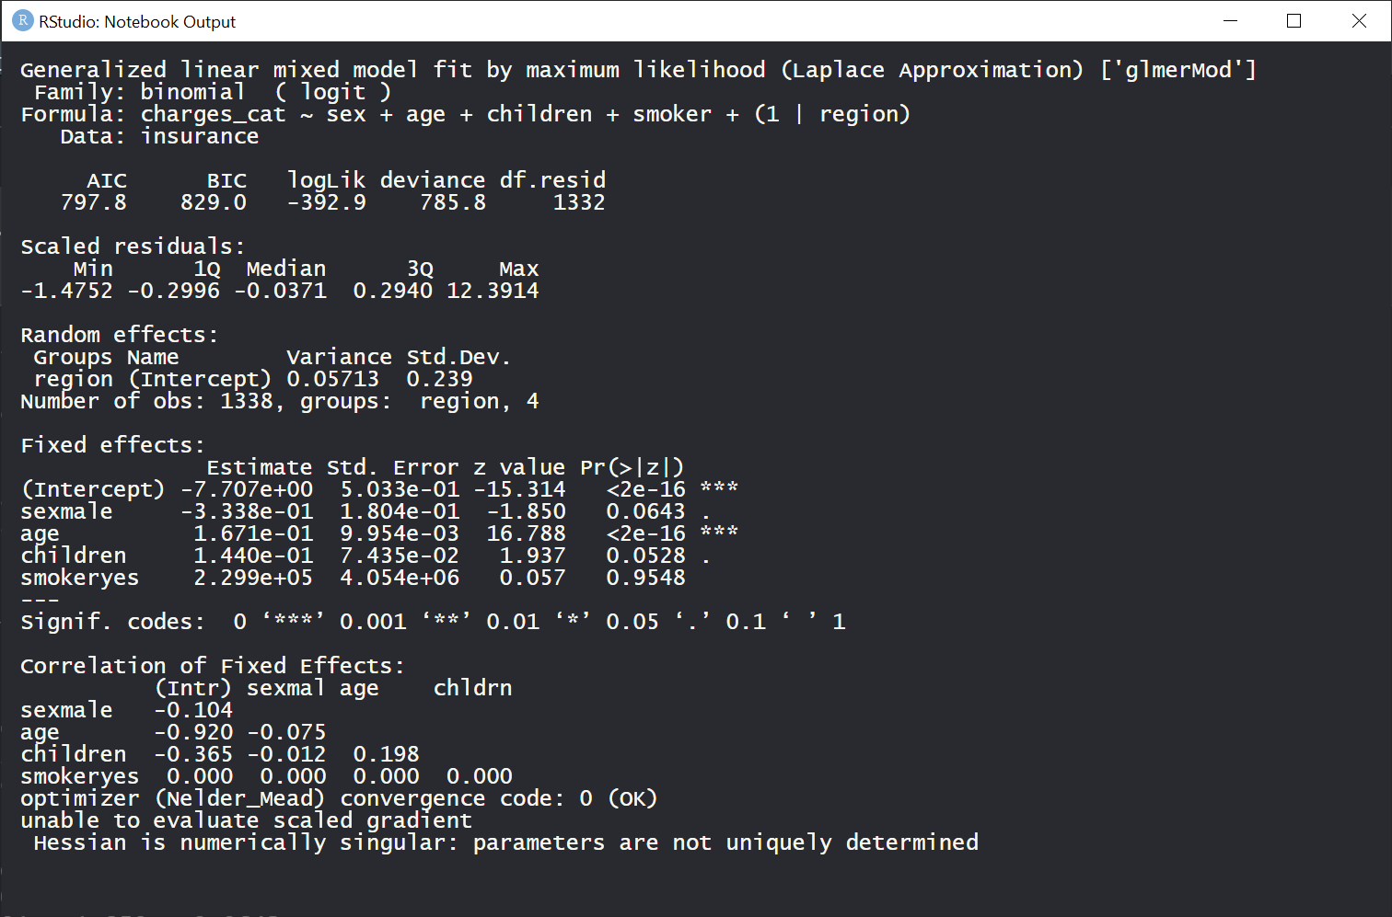
Generalized Linear Mixed Model (GLMM) on logistic regression
Notes:
Ayush: Charges_cat 0 means below median and 1 is above median. We have this variable because we want to make the problem from regression to classification.
If ther

Slide 20
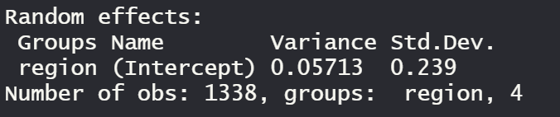
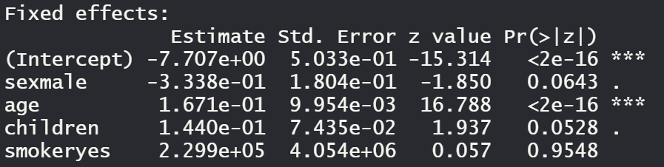
Generalized Linear Mixed Model (GLMM) on logistic regression
Notes:
Ayush:
The variance of the regions here is 0.05713
The coefficients attached to fixed effect are the coefficients of all independent variables in general, without taking into account the different trends (if any) between regions.

Slide 21
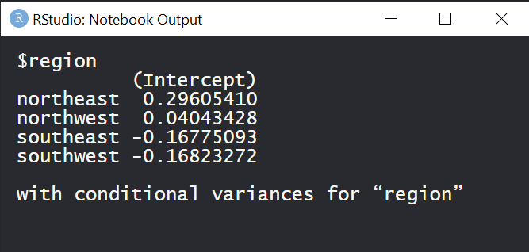
Generalized Linear Mixed Model (GLMM) on logistic regression
Conclusion:
There is not much difference in variance happened between different regions, hence GLMM is NOT needed and GLM is better fit for this case
Notes:
Ayush

Slide 22
Conclusion
We have figured out the features or variables which play vital role in the amount of health insurance as well as the prediction model to help the companies and the customers.
For further analysis, dataset with more features will provide comparatively more accurate outputs.
Notes:
Pari

Slide 23
Thank You
Any questions :) ?
Notes:
Oops typo

